Slide 1
Evaluative
and
Extrapolative Reading

Slide 2
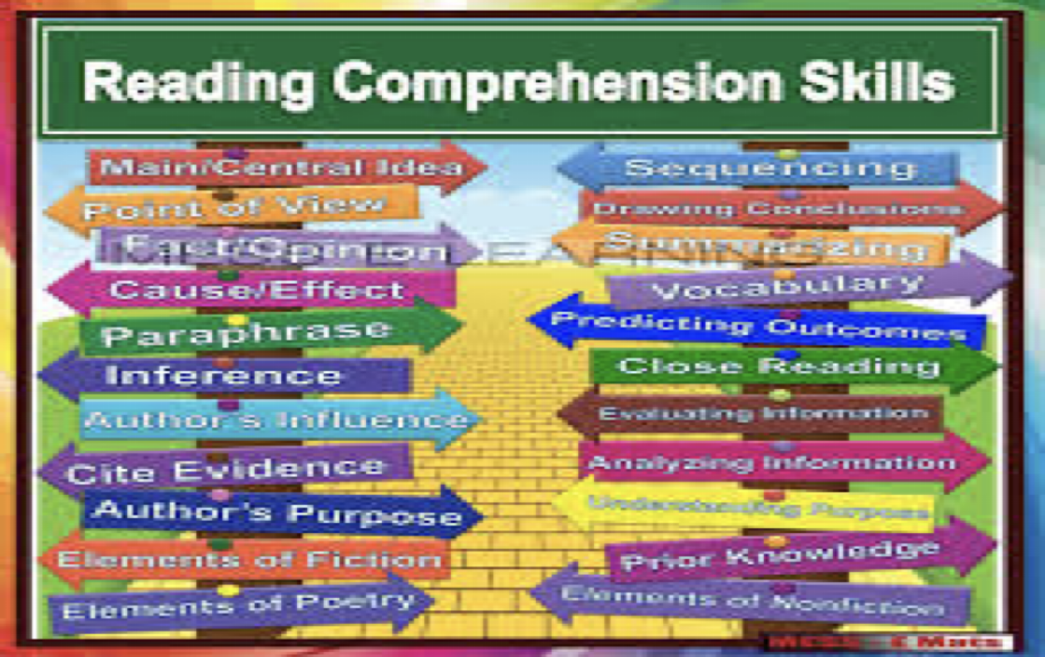

Slide 3
Why Reading?
Reading is a fundamental skill that holds immense importance for several reasons:
Knowledge Acquisition: Reading opens doors to a vast amount of information and knowledge. Books, articles, and other written materials cover a wide array of subjects, allowing readers to learn about different cultures, histories, sciences, and more.
Cognitive Development: Reading stimulates the brain, improving cognitive functions such as concentration, critical thinking, and analytical skills. It also enhances vocabulary and language skills, contributing to better communication abilities.
Empathy and Understanding: Through reading, individuals can experience different perspectives and emotions, fostering empathy and understanding towards others. Literature, in particular, allows readers to step into the shoes of characters from diverse backgrounds.
Mental Health: Reading can be a great stress-reliever. It provides an escape from daily pressures and can be a source of relaxation and comfort. Engaging in reading regularly has been linked to reduced symptoms of depression and anxiety.

Slide 4
Why Reading?
5. Personal Growth: Reading inspires and motivates individuals to pursue their goals and dreams. It can provide insights into self-improvement, personal development, and lifelong learning.
6. Educational Success: Strong reading skills are crucial for academic success. Students who are proficient readers tend to perform better in all subjects, as reading is integral to understanding and following instructions, solving problems, and engaging with educational materials.
7. Career Advancement: In the professional world, reading is essential for staying updated with industry trends, understanding complex documents, and improving job-related skills. It can also enhance one's ability to communicate effectively in written form, a valuable asset in any career.

Slide 5
Impact of Reading on other Skills
Better Writing Skills: Reading diverse types of texts introduces various writing styles and techniques. This exposure helps individuals develop their own writing style, structure arguments coherently, and express ideas clearly.
Enhanced Spoken Skills: Readers often encounter well-constructed arguments and varied expressions, which they can emulate in their own speech. This makes their spoken communication more articulate and persuasive.
Listening Skills: Reading comprehension and active listening are closely related. The ability to understand complex texts translates to better understanding and interpretation of spoken information, making one a more effective listener.
Other skills
Critical Thinking and Analysis: Reading develops critical thinking by encouraging readers to evaluate and analyze information. These skills are vital for engaging in meaningful conversations and discussions, where analyzing and responding to others' viewpoints are crucial.
Cultural Literacy: Reading exposes individuals to different cultures, historical contexts, and societal norms. This cultural literacy enriches conversations and helps in understanding and relating to diverse audiences.

Slide 6
Reading Style
Skimming:
Purpose: To quickly gather the main ideas of a text.
Method: Reading rapidly, focusing on headings, subheadings, and highlighted or bolded terms. Typically involves looking at the first and last sentences of paragraphs.
Use Cases: Reviewing articles, getting an overview of a book, quickly assessing content for relevance.
Scanning:
Purpose: To find specific information within a text.
Method: Moving eyes rapidly over the text, looking for keywords, numbers, or specific phrases.
Use Cases: Searching for dates in a history book, looking for specific data in a report, finding a particular term in a glossar

Slide 7
Reading Style
Intensive Reading:
Purpose: To understand detailed information and gain a deep understanding of the text.
Method: Reading carefully and thoroughly, paying close attention to every word, sentence, and paragraph. Often involves note-taking and highlighting.
Use Cases: Studying textbooks, analyzing literature, reading technical manuals, and preparing for exams.
Extensive Reading:
Purpose: To enjoy the material and improve general reading skills and vocabulary.
Method: Reading for pleasure or broad understanding without focusing on every detail. Typically involves reading longer texts like novels or articles.
Use Cases: Reading novels, magazines, newspapers, and non-fiction books for leisure or general knowledge.

Slide 8
Reading Style
Critical Reading:
Purpose: To evaluate and question the content, considering its validity, relevance, and implications.
Method: Analyzing the text for bias, assumptions, arguments, and evidence. Involves questioning the author’s intent and the strength of their arguments.
Use Cases: Analyzing research papers, evaluating opinion pieces, reviewing persuasive essays.
Analytical Reading:
Purpose: To dissect the text and understand its structure, arguments, and meaning.
Method: Breaking down the text into parts, examining the relationships between those parts, and understanding the logic and coherence of the arguments.
Use Cases: Studying complex theoretical texts, conducting literary analysis, preparing academic critiques.

Slide 9
Comprehension and Reading
Comprehension is the ability to understand and interpret what is being read. There are various types of comprehension, each focusing on different aspects of understanding a text. Here are the primary types of comprehension:
Literal Comprehension:
Definition: Understanding the explicit or literal meaning of the text.
Focus: Facts, details, and directly stated information.
Skills Involved: Identifying main ideas, recalling specific details, and recognizing sequences of events.
Example: Answering questions like "What happened first?" or "Who is the main character?"
Inferential Comprehension:
Definition: Understanding implicit meanings and reading between the lines.
Focus: Making inferences, drawing conclusions, and interpreting implied information.
Skills Involved: Predicting outcomes, deducing motives, and inferring meanings from context.
Example: Answering questions like "Why did the character act this way?" or "What can be inferred about the setting?"

Slide 10
Comprehension Types
Evaluative Comprehension:
Definition: Assessing the text critically, making judgments about its content and quality.
Focus: Evaluating arguments, identifying bias, and assessing the credibility of the text.
Skills Involved: Analyzing the validity of information, critiquing the author's viewpoint, and comparing texts.
Example: Answering questions like "Do you agree with the author's argument?" or "Is the information presented accurately?"
Applied Comprehension:
Definition: Applying information and concepts from the text to new situations or contexts.
Focus: Using knowledge gained from the text in practical or hypothetical scenarios.
Skills Involved: Problem-solving, applying concepts, and making connections to real-life situations.
Example: Answering questions like "How would you use this information in your own life?" or "What changes would you suggest based on the findings?"

Slide 11
Evaluative Reading
Evaluative reading are advanced reading skills that go beyond basic comprehension. These skills involve assessing the value of the text and extending its ideas to new contexts or applications.
Understanding Author's Purpose and Perspective
Identifying the author's intent (to inform, persuade, entertain, etc.).
Recognizing bias and perspective.
Differentiating between fact and opinion.
Critical Analysis of Arguments
Evaluating the strength and validity of arguments.
Identifying logical fallacies and unsupported claims.
Assessing the credibility of sources and evidence.

Slide 12
Evaluative Reading
Assessing the Text's Impact
Analyzing the emotional and intellectual impact of the text.
Considering the effectiveness of rhetorical strategies (e.g., ethos, pathos, logos).
Reflecting on the societal and ethical implications of the text.
Comparative Evaluation
Comparing and contrasting different texts on the same topic.
Evaluating the relative strengths and weaknesses of different arguments or perspectives.

Slide 13
Extrapolative Reading
Extrapolative reading is a higher-order reading skill that involves making predictions, drawing conclusions, and extending ideas beyond the information explicitly presented in the text. This type of reading requires the reader to use their understanding of the text, combined with their own knowledge and reasoning, to infer outcomes, speculate about future events, or apply concepts to new and broader contexts.
Making Predictions
Predicting future developments based on the text.
Extending the text's ideas to potential scenarios or applications.
Connecting to Broader Contexts
Relating the text to historical, cultural, or social contexts.
Applying the text's ideas to current events or personal experiences.

Slide 14
Extrapolative Reading
Generating New Ideas
Using the text as a springboard for original thoughts or hypotheses.
Creating analogies or metaphors based on the text.
Problem-Solving and Innovation
Applying the text's principles to solve real-world problems.
Innovating new approaches or solutions inspired by the text.

Slide 15

Let us Practice

